Slide 1

Performance Measurement System
Final Workgroup
Master in Data Science 2018
Giulia Capestro, Marco Antonio Lanterno, Luca Pedretti, Sanchita Kumari, Mohammed Topiwalla, Valerio Trotta

Slide 2
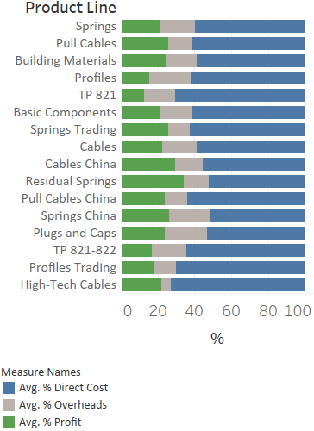
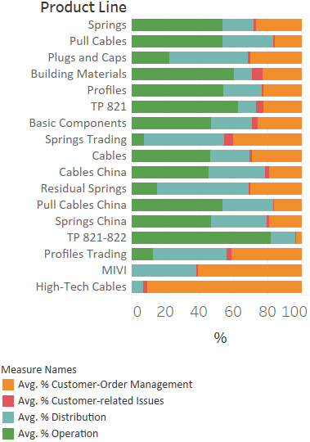
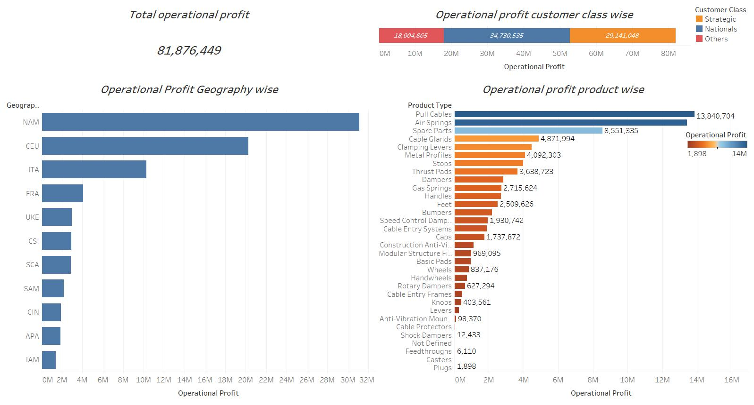

Exploratory Data Analysis
We can see that some products has low operation costs. This means probably that that line are mainly related to trading
We can see that Residual Springs is the most profitable product line. There is one unprofitable product (plugs and Caps
We can see that some products has low operation costs. This means probably that that line are mainly related to trading
Giulia Capestro, Marco Antonio Lanterno, Luca Pedretti, Sanchita Kumari, Mohammed Topiwalla, Valerio Trotta
2

Slide 3
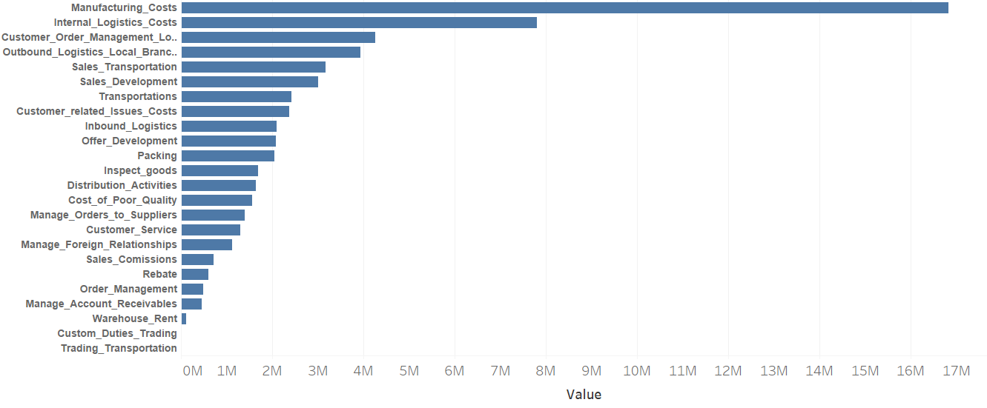
Business Model (Cost Prospective)
Framework
Profitability
Revenues
Costs
COGS
Overheads
Distribution
Operations
Customer & Order Management
Sales Transport.
Packing
Distribution Activities
Trading Transport.
Custom Duties Trading
Warehouse Rent
Oubound Logistic Local Branches
Manufacturing Costs
Quantity
Unit cost
Sales Development
Sales Commision
Offer Development
Order Management
Manage Account Receivable
Cust. & Order Management Loc. Branches
Customer Related Issues
Rebate
Bad Debt
Cost of Poor Quality
Internal Logistic
SupplyChain Management Costs
Transport.
Manage order to suppliers
Inbound Logistics
Inspect Goods
Manage Foreign Relationship
Customer Service
This is the decomposition of the cost accounting method of the company.
In the following slides we try to find cost drivers for each activity through multiple linear regressions.
Our approach to identify relations between cost drivers and activities is to consider just the activities that have an impact on the total overheads. In each regression we consider as dependent variable an activity and as regressors all the possible cost drivers (N°Parts, Assembly Labor Minutes, Machinery Minutes, Number of Deliveries, Average Delivery Batch Size units) with some control variables categorized (Plant, Product Line, Turnover Range and Customer Class)
Giulia Capestro, Marco Antonio Lanterno, Luca Pedretti, Sanchita Kumari, Mohammed Topiwalla, Valerio Trotta
3

Slide 4
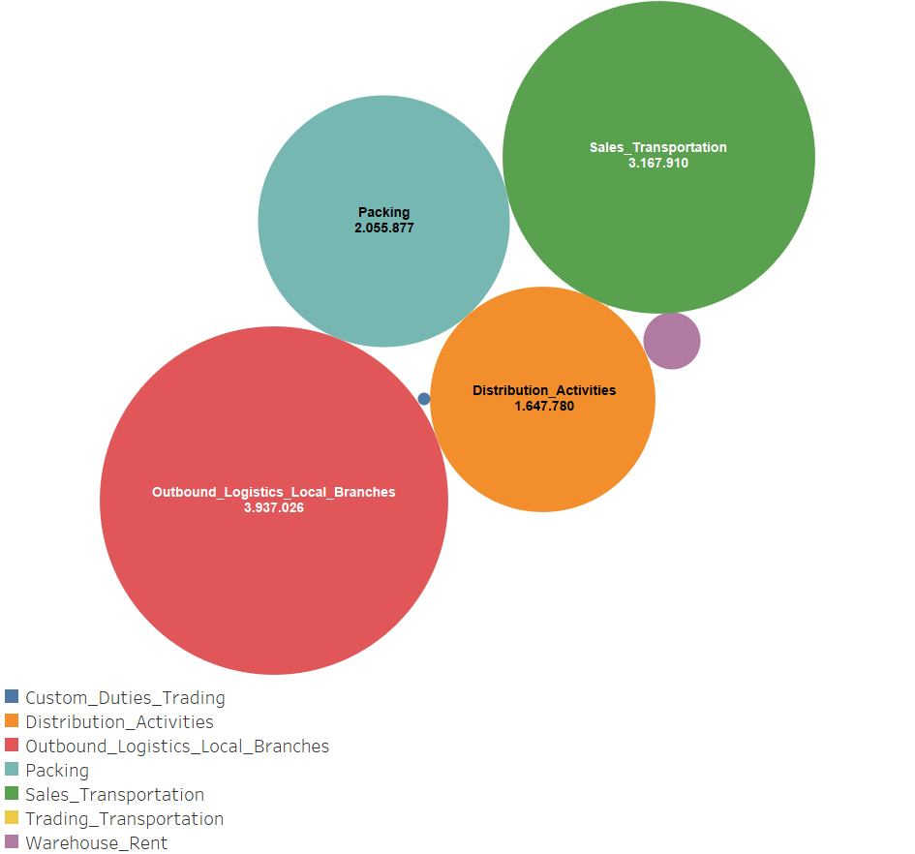
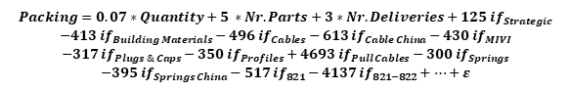
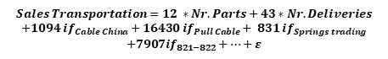
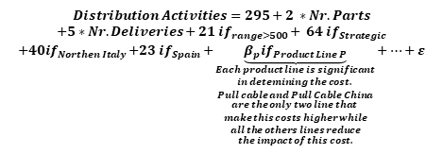
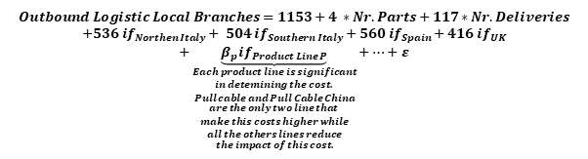
Total Cost of Distribution
Overheads Cost Drivers
$$Sales Transportation=12 ∗Nr. Parts+43∗Nr. Deliveries$$
$$+1094 {if}_{Cable China}+16430{ if}_{Pull Cable}+ {831 if}_{Springs trading}$$
$$+{7907if}_{821−822}+…+ε$$
$$Packing=0.07∗Quantity+5 ∗Nr. Parts+3∗Nr. Deliveries+125 {if}_{Strategic}$$
$$−413{ if}_{Building Materials}−496{ if}_{Cables}−613{ if}_{Cable China}−{430 if}_{MIVI}$$
$$−317{ if}_{Plugs \& Caps}−350{ if}_{Profiles}+4693{ if}_{Pull Cables}−300{ if}_{Springs}$$
$$−395{ if}_{Springs China}−517{ if}_{821}−4137{ if}_{821−822}+…+ε$$
$$Outbound Logistic Local Branches=1153+4 ∗Nr. Parts+117∗Nr. Deliveries$$
$$+536{ if}_{Northen Italy}+ {504 if}_{Southern Italy}+{560 if}_{Spain}+{416 if}_{UK}$$
$$+\underset{\begin{aligned}Each product line is significant \\ in detemining the cost. \\ Pull cable and Pull Cable China \\ are the only two line that \\ make this costs higher while \\ all the others lines reduce \\ the impact of this cost.\end{aligned}}{\underbrace{β_{p}{if}_{Product Line P}}}+…+ε$$
$$Distribution Activities=295+2 ∗Nr. Parts$$
$$+5∗Nr. Deliveries+21{ if}_{range>500}+ {64 if}_{Strategic}$$
$$+{40if}_{Northen Italy}{+23 if}_{Spain}+\underset{\begin{aligned}Each product line is significant \\ in detemining the cost. \\ Pull cable and Pull Cable China \\ are the only two line that \\ make this costs higher while \\ all the others lines reduce \\ the impact of this cost.\end{aligned}}{\underbrace{β_{p}{if}_{Product Line P}}}+…+ε$$
Each circle represents a cost and, with each of them, we reported an equation that highlights the best drivers and their regression's coefficients. The latter show the impact of every regressor over the variability of the related costs. Every regression model is also represented with the R-squared which is an indicator of how much of the variability of the cost is explained by its relation with all the cost drivers included as regressors. In the next slides we are showing as we did the same thing going into details drilling down to activities costs.
Giulia Capestro, Marco Antonio Lanterno, Luca Pedretti, Sanchita Kumari, Mohammed Topiwalla, Valerio Trotta
4

Slide 5
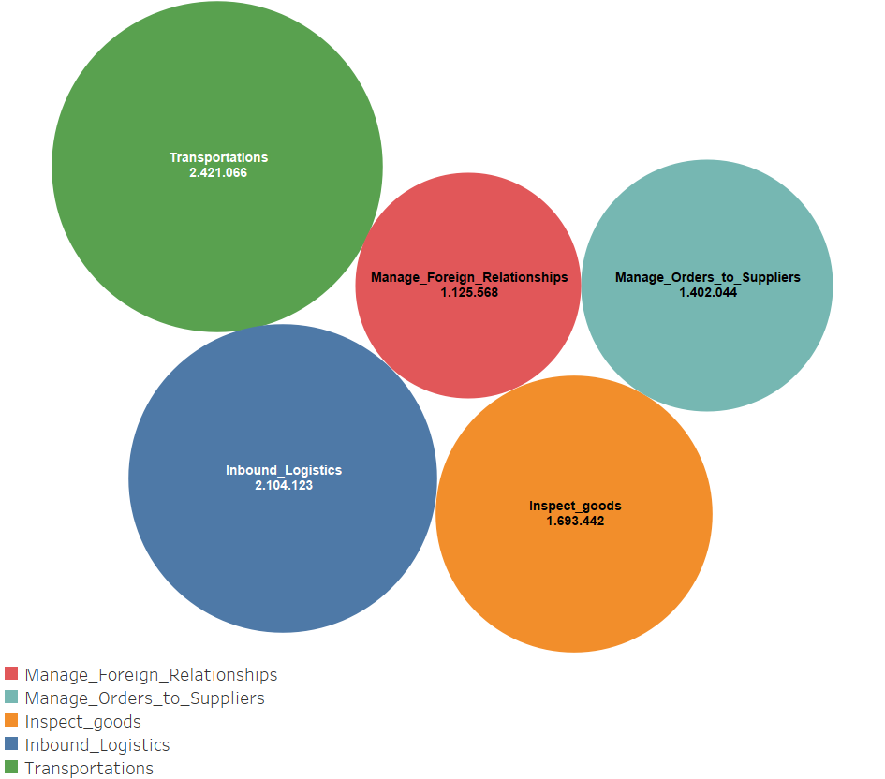
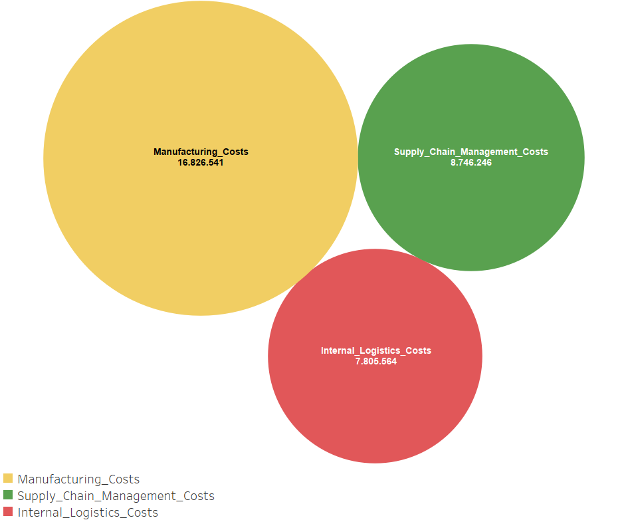
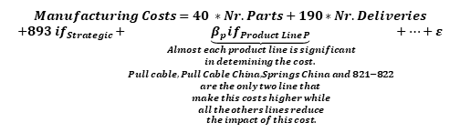
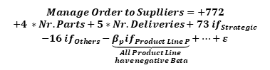
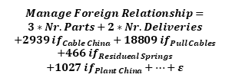
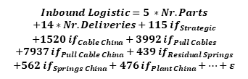
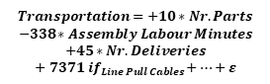
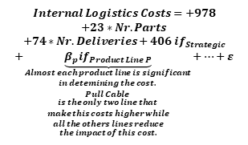
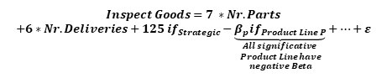
Operations
Overheads Cost Drivers
$$Manufacturing Costs=40 ∗Nr. Parts+190∗Nr. Deliveries$$
$$+893{ if}_{Strategic}+\underset{\begin{aligned}Almost each product line is significant \\ in detemining the cost. \\ Pull cable, Pull Cable China, Springs China and 821−822 \\ are the only two line that \\ make this costs higher while \\ all the others lines reduce \\ the impact of this cost.\end{aligned}}{\underbrace{β_{p}{if}_{Product Line P}}}+…+ε$$
$$Transportation=+10∗Nr. Parts$$
$$−338∗Assembly Labour Minutes$$
$$+45∗Nr. Deliveries$$
$$+{ 7371 if}_{Line Pull Cables}+…+ε$$
$$Manage Foreign Relationship=$$
$$3∗Nr. Parts+2∗Nr. Deliveries$$
$$+2939{ if}_{Cable China}+18809{ if}_{Pull Cables}$$
$$+466{ if}_{Residueal Springs}$$
$$+1027{ if}_{Plant China}+…+ε$$
$$Manage Order to Suplliers=+772$$
$$+4 ∗Nr. Parts+5∗Nr. Deliveries+73{ if}_{Strategic}$$
$$−16{ if}_{Others}−\underset{\begin{aligned}All Product Line \\ have negative Beta\end{aligned}}{\underbrace{β_{p}{if}_{Product Line P}}}+…+ε$$
}
R-squared=0.26
R-squared=0.20
R-squared=0.13
R-squared=0.29
R-squared=0.16
$$Inbound Logistic=5 ∗Nr. Parts$$
$$+14∗Nr. Deliveries+115{ if}_{Strategic}$$
$$+1520{ if}_{Cable China}+3992{ if}_{Pull Cables}$$
$$+7937{ if}_{Pull Cable China}+439{ if}_{Residual Springs}$$
$$+562{ if}_{Springs China}+476{ if}_{Plant China}+…+ε$$
R-squared=0.06
$$Internal Logistics Costs=+978$$
$$+23∗Nr. Parts$$
$$+74∗Nr. Deliveries+406{ if}_{Strategic}$$
$$+\underset{\begin{aligned}Almost each product line is significant \\ in detemining the cost. \\ Pull Cable \\ is the only two line that \\ make this costs higher while \\ all the others lines reduce \\ the impact of this cost.\end{aligned}}{\underbrace{β_{p}{if}_{Product Line P}}}+…+ε$$
$$Inspect Goods=7 ∗Nr. Parts$$
$$+6∗Nr. Deliveries+125{ if}_{Strategic}−\underset{\begin{aligned}All significative \\ Product Line have \\ negative Beta\end{aligned}}{\underbrace{β_{p}{if}_{Product Line P}}}+…+ε$$
R-squared=0.23
We further analyzed the composition of the operation costs. As said before, we can read the equations to obtain more details on how cost drivers contribute in explaining the variability of each activity cost. This set is composed by the best regression models that we could have found and unfortunately none of the R-squared in here is higher than 29%. We’re putting a table at the end of the presentation to help with the comparison and final assumption.
Giulia Capestro, Marco Antonio Lanterno, Luca Pedretti, Sanchita Kumari, Mohammed Topiwalla, Valerio Trotta
5

Slide 6
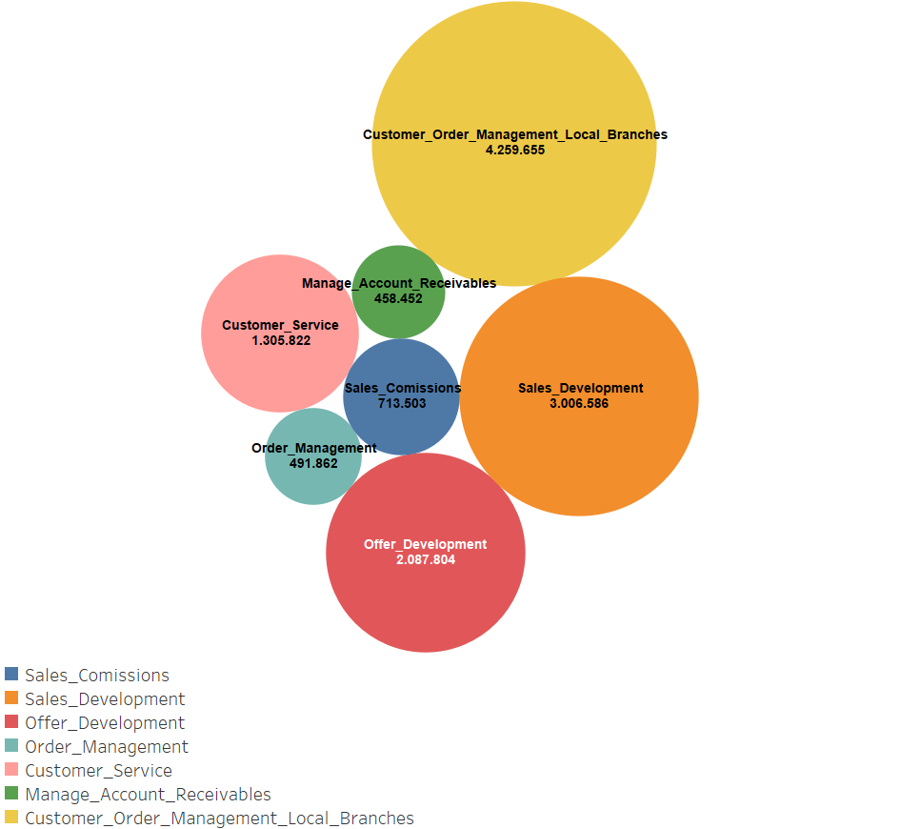
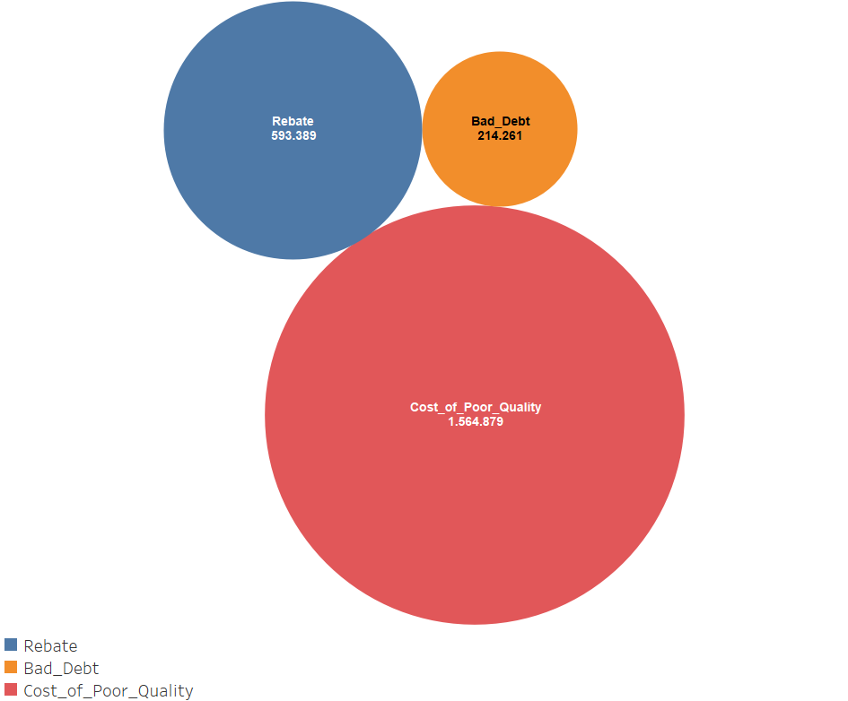
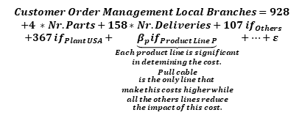
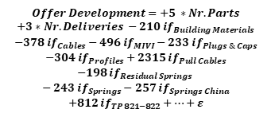
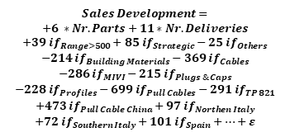
Customer & Order Management Customer Related Issues
Overheads Cost Drivers
$$Customer Order Management Local Branches=928$$
$$+4 ∗Nr. Parts+158∗Nr. Deliveries+{107 if}_{Others}$$
$$+{367 if}_{Plant USA}+\underset{\begin{aligned}Each product line is significant \\ in detemining the cost. \\ Pull cable \\ is the only line that \\ make this costs higher while \\ all the others lines reduce \\ the impact of this cost.\end{aligned}}{\underbrace{β_{p}{if}_{Product Line P}}}+…+ε$$
We can see a strong relation between this activities and the number of deliveries.
R-squared=0.48
We wasn’t able to find any significant relations to explain the variability of this three activities. Customer Issues have a variability difficult to explain being very difficult to predict
R-squared=0.48
$$Sales Development=$$
$$+6 ∗Nr. Parts+11∗Nr. Deliveries$$
$$+39{ if}_{Range>500}+85{ if}_{Strategic}−25{ if}_{Others}$$
$$−214{ if}_{Building Materials}−369{ if}_{Cables}$$
$$−286{ if}_{MIVI}−215{ if}_{Plugs \& Caps}$$
$$−228{ if}_{Profiles}−699{ if}_{Pull Cables}−291{ if}_{TP 821}$$
$$+473{ if}_{Pull Cable China}+97{ if}_{Northen Italy}$$
$$+72{ if}_{Southern Italy}+101{ if}_{Spain}+…+ε$$
R-squared=0.44
$$Offer Development=+5 ∗Nr. Parts$$
$$+3∗Nr. Deliveries −210{ if}_{Building Materials}$$
$$−378{ if}_{Cables}−496{ if}_{MIVI}−233{ if}_{Plugs \& Caps}$$
$$−304{ if}_{Profiles}+2315{ if}_{Pull Cables}$$
$$−198{ if}_{Residual Springs}$$
$$− 243{ if}_{Springs}−257{ if}_{Springs China}$$
$$+812{ if}_{TP 821−822}+…+ε$$
Giulia Capestro, Marco Antonio Lanterno, Luca Pedretti, Sanchita Kumari, Mohammed Topiwalla, Valerio Trotta
6

Slide 7
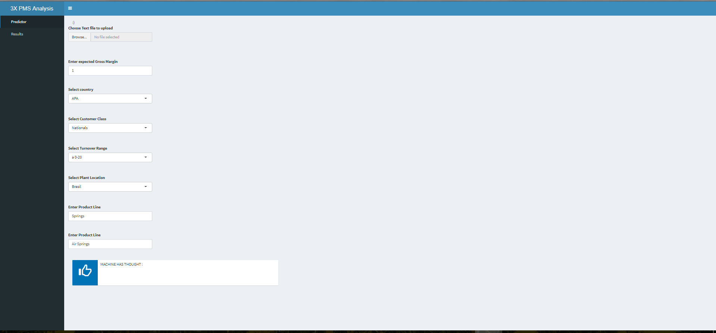
Cost Configurator
Want to understand what would be the cost of a new customer?
https://mohammedtopiwalla.shinyapps.io/PMS_Analysis/ - Go here to find it out
This is how you could operate it
You could use this data to operate it
There is scope for improvement in the app (From the perspective of different cost drivers)
Giulia Capestro, Marco Antonio Lanterno, Luca Pedretti, Sanchita Kumari, Mohammed Topiwalla, Valerio Trotta
7

Slide 8
Conclusions
Packing | Outbound Logistic and Local Branches | Distribution Activities | Sales Transportations | Manufacturing Costs | Internal Logistic Costs | Transport.
0,07*Quantity 5*N°Parts 3*N°Deliveries | 4*N°Parts 117*N°Deliveries | 2*N°Parts 5*N°Deliveries | 12*N°Parts 43*N°Deliveries | 40*N°Parts 190*N°Deliveries | 23*N°Parts 74*N°Deliveries | 10*N°Parts 45*N°Deliveries -338*Assembly labour minutes
Manage Foreign Relationship | Manage Order to Suppliers | Inspects Goods | Inbound Logistics | Customer Order Management Local Branches | Offer Development | Sales Development
3*N°Parts 2*N°Deliveries | 4*N°Parts 5*N°Deliveries | 7*N°Parts 6*N°Deliveries | 5*N°Parts 14*N°Deliveries | 4*N°Parts 158*N°Deliveries | 3*N°Parts 5*N°Deliveries | 6*N°Parts 11*N°Deliveries
Giulia Capestro, Marco Antonio Lanterno, Luca Pedretti, Sanchita Kumari, Mohammed Topiwalla, Valerio Trotta
8

